Slide 1
Why I Kept Silent About My Eating Disorder, and Why Coaches Shouldn't
Rachael Steil
Author, Speaker, Coach

Slide 2
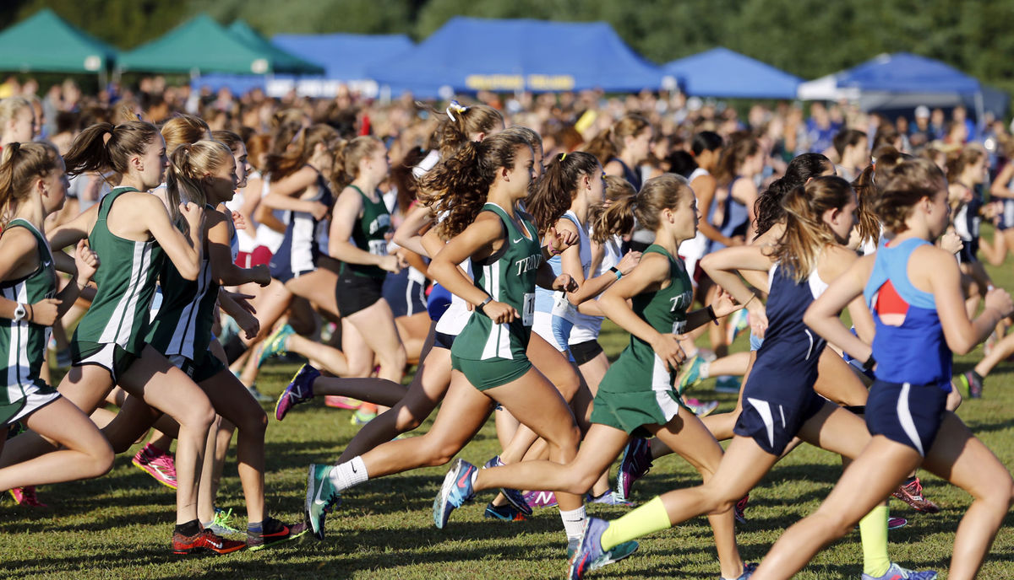

Slide 4
“One study found [eating disorders] to be 2-3 times more common in competitive athletes than the general population, particularly among endurance sports.” Anything for this: The costs, benefits of life in elite sport, (Mara Abbott) http://www.espn.com/

Slide 5
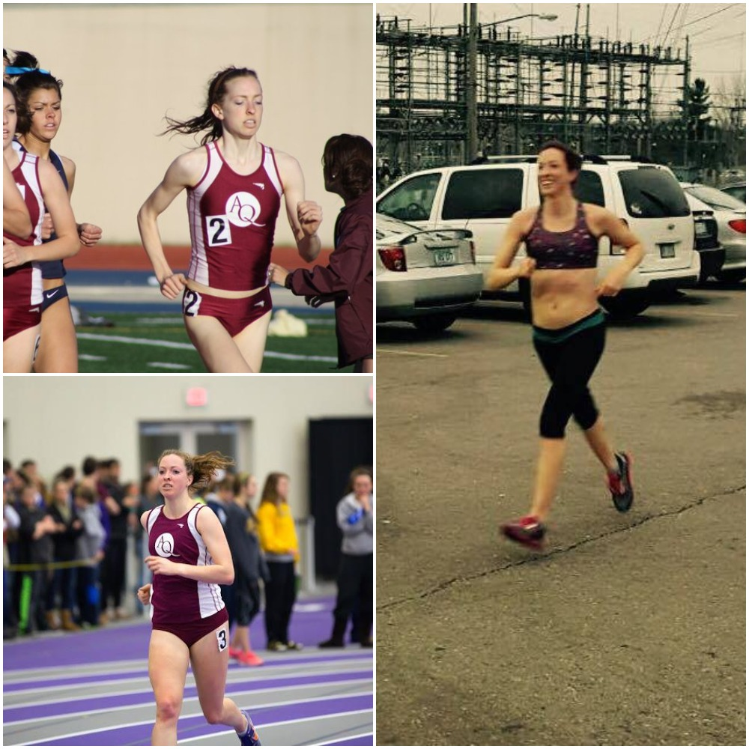
I. My Story II. Causes III. As a Coach, How to Approach IV. Recovery Write down your questions!

Slide 6
High School PRs
Freshman: 19:32
Sophomore: 19:11
Junior: 18:32
Senior: 18:27

Slide 7
. . . and then she “disappeared”
26th All-State 2009, 19:11
6th Place All-American NAIA 2010, 17:37

Slide 8
Anorexia
Vegetarianism?
Calorie counting (secretly)
Strict sleep schedule
Isolation
Sluggish, tired
Difficulty concentrating
Emotional eating?
Rigid schedule
Gum chewing
Food restriction
Large meals low in calories
EX: Large salad, no dressing
Cooked vegetables, little meat/no sauces
Monitoring parent meals
Food research/nutrition “expert”

Slide 9
Misconceptions
WAS still eating
OBSESSION with food
Not “bad” enough

Slide 10
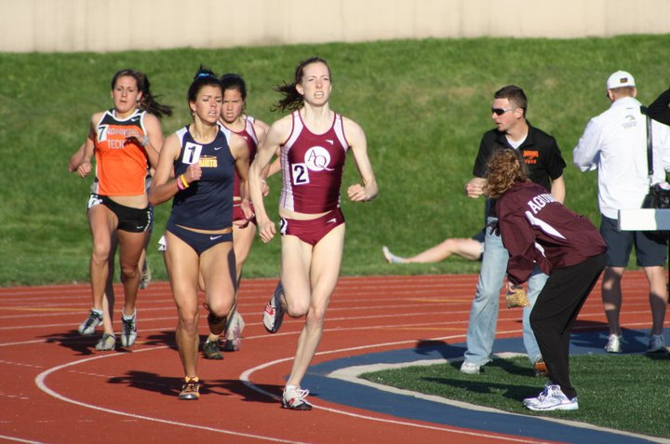
Cross country:
6th place NAIA All-American
Track:
7th place NAIA All-American
--Social life suffering
--Rigid schedule
--Worried about giving in to “too much” food

Slide 11
Raw Food Diet
Raw fruits, vegetables, nuts & seeds
Nothing heated over 118 degrees
Keep eating disorder without weight gain??

Slide 13
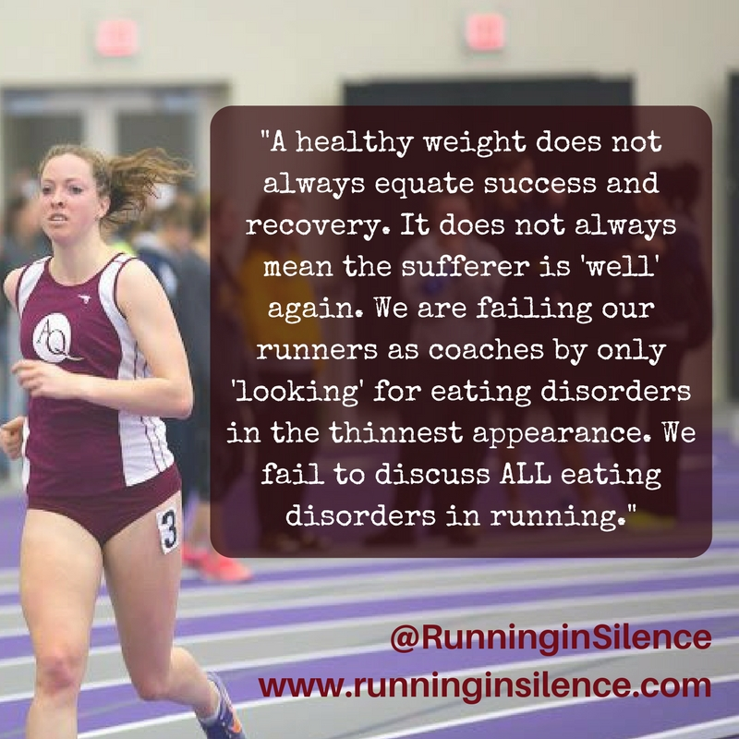
Binge Eating
Large amount of food in short amount of time
Shame, guilt, discomfort
Discipline, willpower?

Slide 14
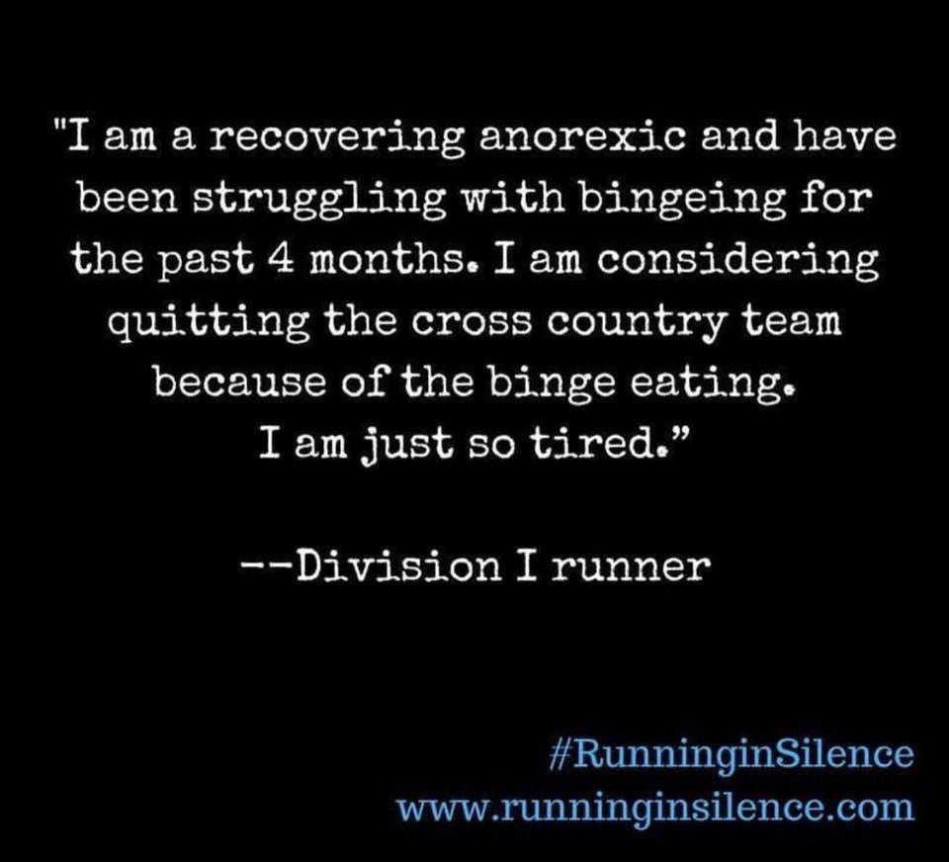

Slide 16
High School vs College PRs
Freshman HS: 19:32
Sophomore HS: 19:11
Junior HS: 18:32
Senior HS: 18:27
Freshman College: 17:04
Sophomore: Redshirt
Junior: 18:26
Senior: 18:50
5th Year Senior: 20:01

Slide 17
II. Causes
Competitive running PART of the trigger?
Eating disorder already present?
People drawn to running:
Hard work
Discipline
Pushing through pain
Attention to numbers
Perfectionism
Persistence
High self-expectation

Slide 18
Causes
Coaches?
Can happen to the BEST of coaches!
Comments to avoid
We CAN talk about these issues!

Slide 19
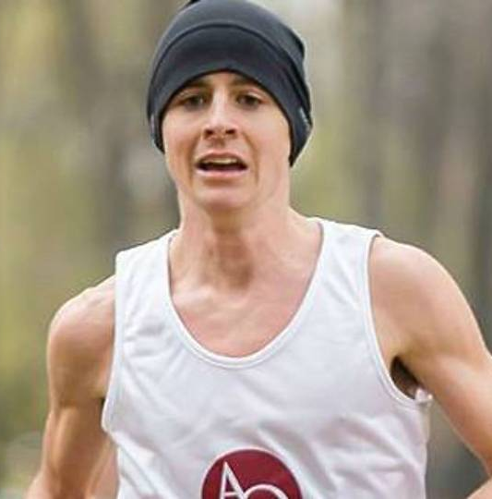
III. As a Coach, How to Approach
MENS teams also!
“[M]ales are at higher risk of dying as a result of their eating disorders. The suggestion is that this may be because they wait for longer before seeking help."
Shining on a light on male eating disorders (Sharon Conchuir) http://www.irishexaminer.com
Female Athlete Triad (FAT) vs Relative Energy Deficiency in Sport (RED-S)

Slide 20
As a Coach, How to Approach: Parent Meeting
Play important role in recognition
Symptoms
BEHAVIOR-based, not appearance

Slide 21
As a Coach, How to Approach: Team Meeting
Balance
Senior input
Nutrition
More running = more hunger!
Post-workout fuel
80/20 vs 100% “perfect”
Lists of carbs, proteins, fats

Slide 22
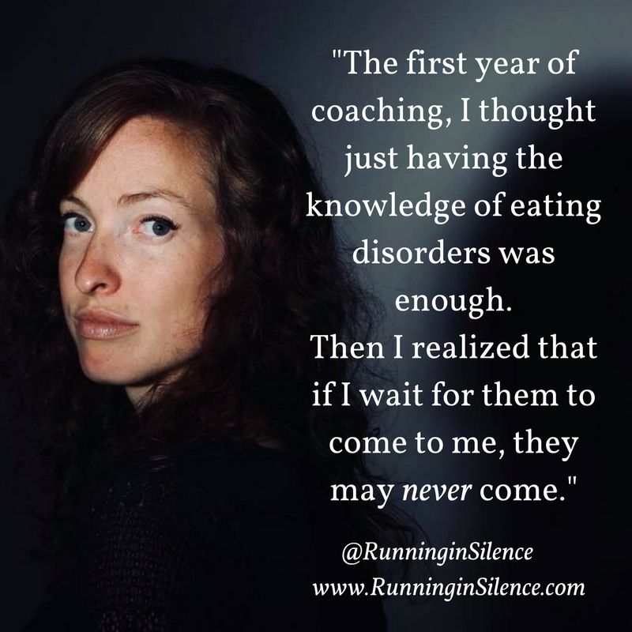
As a Coach, How to Approach: Team Meeting
TALK about it!
Will prompt them to seek help sooner, recover sooner
Discourage body comparisons
Can’t prevent all eating disorders
Show physical AND mental well-being important

Slide 23
As a Coach, How to Approach: Team Meeting
NOT about appearance
Restricting OR bingeing, or compensatory behaviors
Preoccupation with food
Anxious about what or how much to eat
Feeling shame and guilt when eating
Hoarding food
Eating only “safe” food, usually low in fat and calories
Strange food combinations
Isolation
Cutting out entire food groups

Slide 24
Approaching an Athlete
No comments on weight/appearance
BEHAVIOR-based approach
Can’t make diagnosis
Don’t need to FIX—LISTEN!
Notify parents/guardians
LEAD them to professional help
Can ask to stay involved

Slide 25
As a Coach, How to Approach: Team Meeting
Values:
Hard Work Balance
Teamwork
Improvement

Slide 26
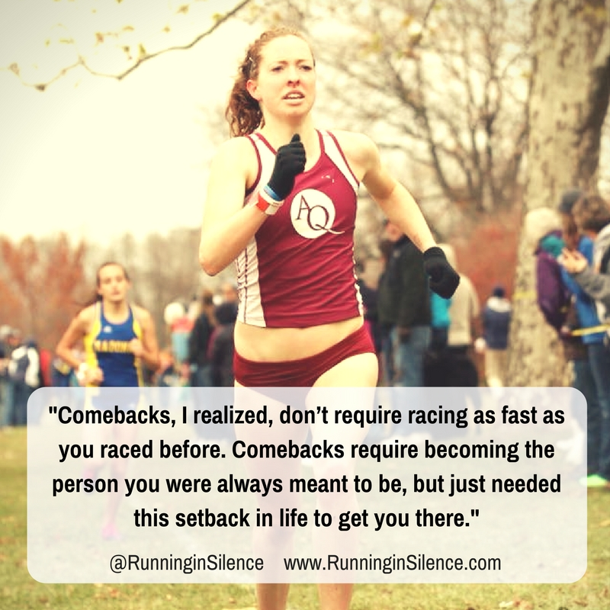
IV. Recovery
Support group, therapist, dietitian, parents, coach
Acceptance
Discovery/Identity
Fueling ENOUGH—trust

Slide 28
Website: www.RunninginSilence.com
Email: RunninginSilence@gmail.com

Slide 29
Main Takeaways
Understand the prevalence
Can’t always prevent, but can RECOGNIZE
Talk
Support
Listen
Not heal, but DIRECT

Slide 31
“This is the best eating disorder and sports book I’ve ever read. And believe me, I’ve read them all. A very honest account of the reality of eating disorders in sports.”
~Paula Quatromoni, DSc, RD, Boston University Associate Professor and Chair, Department of Health Sciences; Senior Consultant at Walden Behavioral Care
“Running in Silence is a gift because it is a voice speaking honestly about eating disorders in running. It is a valuable tool. My hope is that Rachael's bravery and strength will encourage many to open up and seek help, as this book did for me.”
~NCAA Division 1 cross country runner
“We need more stories like this with guidance. It’s a helpful book, especially to educate parents, coaches, and athletes. Running in Silence will encourage anyone to get that push they are looking for to not merely exist, but to live.”
~Suzy Favor Hamilton, former Olympic middle distance runner
Running in Silence is a must-read for anyone who wants to better understand the causes and potential cures of eating disorders.”
~Lize Brittin, former world-class mountain runner

Slide 32
Website: www.RunninginSilence.com
Email: RunninginSilence@gmail.com

