Slide 1
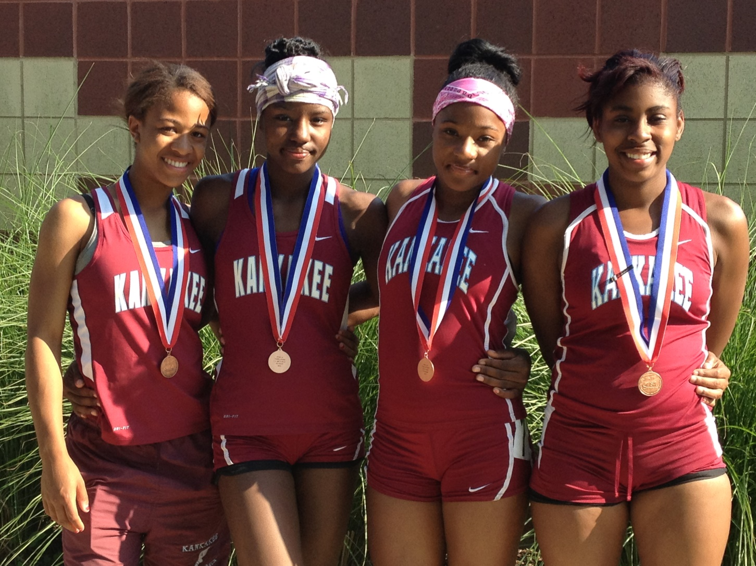
Building Your Sprint Programs Through 400 Meter Training

Slide 2
What Does It Take
The 400 Meters is an endurance, speed, and power event
400 M race brings a high level of mental focus, attitude and toughness
For some athletes these qualities are natural, for others they are present but need to be strengthened.

Slide 3
Know Your History Because It will Tell You Their Story
1989 to 2009 Coach Burgard, Head Track and Field Coach at Kankakee (cross country when they had it) had built a solid tradition in Girls track but in recent years the track team had fallen on hard times.
This was a culture that athletes wanted to be a part of but did not want to work. So we needed to get back that tradition and culture of hard work and make it stronger today than they were back then. (4th place in 1997 and 21 relays placed)

Slide 4
What You Will Need To Do
2009-10 - I took over as Head Track and Field Coach. I made a conscious effort to think about what tradition I wanted to establish to contribute to what Coach Burgard had created.
After falling short of a team trophy at the state meet during the 2009-10 and 2010-11 seasons and evaluating performances, I realized the stress of winning a championship was put on one sprinter.

Slide 5
What You Need To Do
Coaches need to decide what their base method of training for all of the events coached are going to be.
As track and field coaches we all have the understanding, commitment and passion that coaching multiple events is what we do.

Slide 6
Know Who You Are And Where You Want To Go
When I took over the job at Kankakee
  Coach Hillman: All Jump
  Coach Hawes: Throws
  Myself: Sprints, Hurdles and Relays (Distance was 800 meters to these girls)
  I knew the events that I coached, all to some degree had components of endurance, speed and power.
  I have developed this philosophy because of the coaching positions I had been placed in previously.

Slide 7
Know Who You Are And Where You Want To Go
Joliet Township – Rebuild
  2001 USA Track & Field Level 1
  2002 Vince Anderson U of Tennessee – (Now at Texas A&M) helped with workouts
Hillcrest – Rebuild (Test what I know)
  2003 USA Track & Field Level II Sprints, Hurdles and Relays
Providence – Rebuild (New Millennial Records)
  2005 USA Track & Field Level II Jumps
Hillcrest – Win State (3 yrs.) Leave it better than you got it and be the best Asst. you can be!
Kankakee – Rebuild (New Start)

Slide 8
Why We Do What We Do
In 2005 American Track and Field Magazine published an article written by Andy Friedlander about Coach Clyde Hart on the 400 (Train Slower to Race Faster)
This article will change (or not) the way you think about developing your plan of training 400M runners.
Vince Anderson told me to find 5 things that I can do well and do them.
In my Level II Training, I put together a Periodization Program and Chart for Track and Field. So I have decided over the years that we were going to commit to building our team around the 400.
We have become very competitive in the 4x1, 4x2, 4x4, 100, 200 and the 400 (we do ok in the 4x8 to win in our area)

Slide 9
Who Do You Look for in the Hallways, Gym classes and other sports
Recruit all sports with enthusiasm and tell them how you can help with their sport
Recruit PE teachers to promote your sport
In the hallways we had to focus attention on athletes that could do multiple events and not just be event specific (testing)
With 400m/300H athletes they have the ability and range to go up/down

Slide 10
Range of Ability
400 Meters 200 Meters
400- up 600 – 800 200- up 400 – 600(800?)
200 100 (4x100) (4x200) (4x400)
100 (4x800) (4x100) (4x200) (4x400)

Slide 11
Range of Ability
300 Hurdles 100Hurdles
300H – up 600 – 800 100H – up 200 – 400 up 300H
400 (4x800) (4x400) 100 (4x100) (4x200)
100 Meters
200 (4x100) 100 – up 200 – up ?
100 (depending on 100H speed) 4x100

Slide 12
Athletes’ Example of Range
Brittney Griffin – Never ran Shaneequa Hubert – ran 400m in
Track before High school. Jr. High.
100m 12.7 100m 12.8
100h 17.0 200m 26.0
300h 47.9 400m 59.06
400m 60.2 600m 1:31.5
4x100R 800m 2:24.9
4x200R 4x100 R
4x400R 4x200R
Long Jump 17’9” 4x400R
                4x800R
                High Jump 5’ 0”

Slide 13
Training The 400M
Focus on Two Types of Runners
  Speed and power runners
    Will get out hard, maintain, and works to hold on during last 100M
  Strength and endurance runners
    Get out slower, but has ability to increase speed with the least amount of effort. Getting stronger as the race gets longer. As this runner matures, the 800m could become their better event w/more mileage and over-distance training

Slide 14
Key Factors in 400M Training
Developing a 400 mindset
Developing an endurance base
Developing a speed base
Developing a strength base
Technique (how to run it) the 4 P’s
Push, Pace, Positioning, and Pride (Passion, Pray)
How to handle physical stress
The understanding of increasing speed with the least amount of effort (being able to finish)

Slide 15
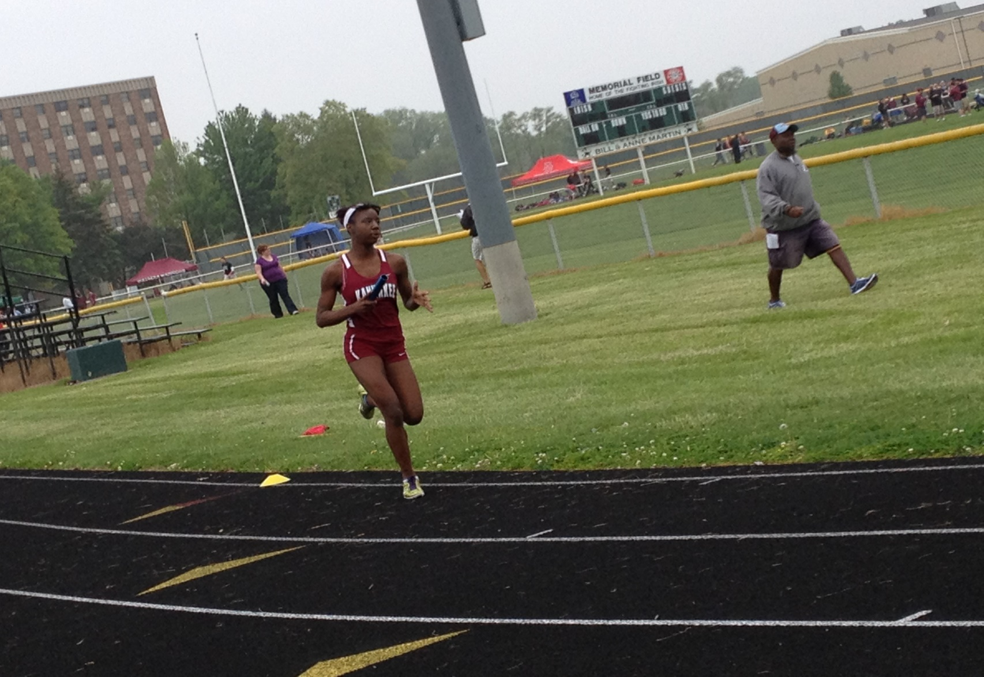
Key Factors in 400M Training

Slide 16
Breaking Down the Complete 400 Race
1st 100M is a Push out of the blocks
2nd 100M is a control/Pace
3rd 100M is maintaining and Positioning
Next 75M is focus/finish, the ability to increase speed with the least amount of effort
Last 25M is attitude, drive, Passion; some just have it and others can be taught it

Slide 17
Weekly Workout Schedule
Monday –
Speed endurance: 100 – 400, 100H
Speed endurance/Tempo endurance: 400/300H/800
We workout one hard day a week - Monday

Slide 18
Sample Workout:
200’s – working on a 9 week schedule
Week 1 – 12x200’s in or under 45 min
Week 2 – 11x200’s in or under 40 min
Week 3 – 10x200’s @ 36 women
Week 4 – 10x200’s @ 36 women
Week 5 – 9x200’s @ 34 women
Week 6 – 9x200’s @ 34 women
Week 7 – 8x200’s @ 32 women
Week 8 – 8x200’s @ 32 women
Week 9 – 8x200’s @ 32 women
* Note at week 5: 300MH/400/800 are running broken 400s and focus is hitting time on 1st 200M and 2nd 200 M is a good tempo finish

Slide 19
Wednesdays – A Power Speed Day
100, 200, 400, 110H/100H will run nothing longer than a 200
  10x20 @ 90-95 %
  10x30 @ 90-95 %
  4x133 @ 70% of 400M pace for race
  4x133 @ 75% of 400M pace for race
400/300H/800 starts practice with a tempo run of 5 minutes, 10 minutes, 12 minutes. Will run nothing longer than a 400

Slide 20
Sample Workout Everyone
Kay’s 30 minute
Indoors Outdoors
9 weeks (each in 3 week set) times drop each week
Week 1 – 800 – 600 – 300 – 300 – 200 – 200 – 200
(3:54) (2:00) (:59) (:59) (:37) (:37) (:37)
Week 4 – 800 – 500 – 300 – 250 – 150 – 150 – 150
(3:36) (1:33) (:56) (:45) (:25) (:25) (:25)
Week 7 – 800 – 450 – 250 – 250 – 100 – 100 – 100
(3:18) (1:19) (:39) (:39) (:16) (:16) (:16)
Clock * 0:00 8:00 17:00 19:00 27:00 28:30 30:00

Slide 21
Tuesday/Thursday
Strength Training
30 to 45 minutes of Olympic lifts
  Bigger, Faster, Stronger
  Complex I (Mrs. Hillman)
Speed Development/Block Work
Technique work for Hurdles
Relay Handoffs
Rest and Recovery/Video, DVD Day
  Team warm up/easy temp run
  Training room treatment (my own)
  Pool workout
  Video, watch event from previous week’s meet (teachable moments)

Slide 22
2013 Class 2A Girls State Meet Final Results 4x100 Relay
Kankakee 48.23 (224)
Springfield SE. 48.23 (230)
Melrose Park W.L. 48.35
Bloomington 48.49
Chatham (Glen) 49.03
East St. Louis 49.27
Geneseo 49.59
Morton 49.87
Dunlap 49.92

Slide 23
Former/Current Providence, Kankakee Sprinters/ Hurdlers
Eleen Moran (Providence Catholic) 2006
  5th place 400m (57.53 FAT) School Record
Dominique Kimpel 2011
  3 time state Champion 100m (11.69) School Record
  3 time state Champion 200m (24.08) School Record
  2nd in the 400m dash (55.75) School Record
Tyjuana Eason Present
  2 years placed 100m dash (12.26) Personal Best
  7th place 200m dash (25.88) Personal Best
  57.7 400m Dash
Jemiya Bates Present
  7th place 100m Dash (12.27)
  State Q 200m Dash (26.24)
4x100 Relay 2010 State Champions (48.34)
4x100 Relay 2013 State Champions (47.94) (Semi) School Record
4x200 Relay 2013 3rd place (1:41.45) School Record

Slide 24
Thank You!
Kankakee Girls Track Website:
  www.ksd111.org
If you have any questions or concerns please feel free to contact me!
  Benny-Phillips@ksd111.org
  phillips311@att.net
  815-210-8409

