Slide 1
Beginning Triple Jump (Video and pictures to accompany presentation)
Chuck Hilby
Horizontal Jumps Coach
West Aurora High School

Slide 2
Desired Athlete
Speed
Strength
Body control
Competitive
Mentally strong
Multi-sport athlete
First time triple jumpers (undoing previous sins)
Tell athletes you are looking for long jumpers, then bound
Have a good, smart head coach

Slide 3
Complete Jump
Maintaining the horizontal velocity/momentum generated in the approach is the key to a great triple jump
Skipping a stone
Each phase about one-third of the total jump (34/27/39)
LLR vs RRL – Try both – It will likely be an athlete preference
Posture throughout – stay tall, hips high
“Tall and bouncy”
Importance of foot contact points – avoid reaching
Levers – the longer things are on the back, the longer they will “sweep” forward to the front side

Slide 4
Approach
Consistency is key
Most high schoolers will be 14-18 steps
Slower = Shorter, Faster = Longer
Pre-take off routines vary but the end must be the same
Take off – feet about 1 foot apart, front foot ready to roll, 90 degree bend at the waist
Big push – full extension of the push off leg (feel it behind you)
Problems at the board likely originate from inconsistency at the take off
Be careful with moving an athlete’s mark

Slide 5
Approach (continued)
First third of the approach is power/build-up/drive steps – head down and forward lean, similar to driving out of blocks
Middle third is about maintaining built up power and speed – good tall posture and rhythm, heel to butt motion (leads to good knee drive)
Final third is about the athlete prepping to jump – hips will drop on penultimate step but should not be as pronounced as long jump
Pros and cons of looking at the board
Final step – HJ vs LJ vs TJ (Willie Banks)
Better to have proper take off from behind the board than to reach
Single arm vs double arm

Slide 6
First Phase (Hop)
If first phase is too high, much of the horizontal velocity will be lost
Run off the board – drive out, not up
Take off angle must be significantly less than long jump angle
Feel the foot behind you pushing out
With a good extension of take off leg, the leg will naturally rotate through – the rotation shouldn’t need to be over-coached
Front thigh should lead the take off and aid a good leg split

Slide 7
First Phase (continued)
Single arm vs double arm adjustments
Landing – dorsiflexion – see the bottom of the foot from the pit
Foot strike should be active, rolling/pawing motion – heel first
Landing toe first will create braking
Foot strike will be slightly in front of the center of gravity but don’t reach
Don’t be a hero on the first phase

Slide 8
Second Phase (Step)
“How does he have such a good second phase?”
Second phase goes nowhere without a proper first phase
A low first phase keeps the momentum going towards the pit whereas a high first phase takes the momentum into the ground
A good, flat, rolling foot contact coming off the first phase should lead to an active second phase
At touchdown of the first phase, trail leg should be well extended behind athlete, prepping for a long sweeping motion into second phase
At touchdown of first phase, arms should also be behind athlete, prepping to drive forward with the trail leg
Angle of second phase should still be conservative – usually not a problem
Still trying to maintain horizontal velocity

Slide 9
Second Phase (continued)
Similar to the first phase take off, feel the foot behind you pushing out
“Jump/Leap/Bounce/Bound” – whatever works
As trail leg sweeps through, be patient in the air – feel the float
Use caution with telling athlete to “drive” or “lift” the knee
A solid push from trail foot should lead to good leg split and a natural rise of the lead thigh to a parallel position with the ground
Arms should drive forward at take off and then back during jump
As front foot reaches out, leg should rotate through in a backward and downward motion
The active, rolling/pawing foot strike lands just ahead of the center of gravity
Again, foot should be dorsiflexed for a heel, not toe, landing

Slide 10
Third Phase (Jump)
Ideally greater than one-third of total, but not at expense of second phase
Third phase takes a long jump angle – greater than previous phases – think up and out
Maintaining horizontal velocity is no longer necessary – maximize time in the air
“Just making the pit” mentality
Upon second phase landing, lead foot is active, free leg and arms are well behind athlete
Arms and free leg should swing through aggressively
Be “big” in the air – chin up, chest up – delay forward rotation

Slide 11
Landing
Knees to chest, head up to prevent over-rotation, drive the hands down and back, legs horizontal just prior to impact
Keep shoulders square to prevent one foot in front of other
Feet enter the sand by way of the heel and back of foot – grab the sand and pull
Upon impact, knees collapse and butt replaces foot holes in sand
Alternatively, using a pulling motion with the feet, body can land to side of the feet marks

Slide 12
Drills/Training
Walking drills
General bounding
Progressive cone drill
Phases into the sand
Short approach jumps
1st – 1st – 2nd – 3rd
Approach Steps
Anything competitive
Plyos
Hamstring complex

Slide 13
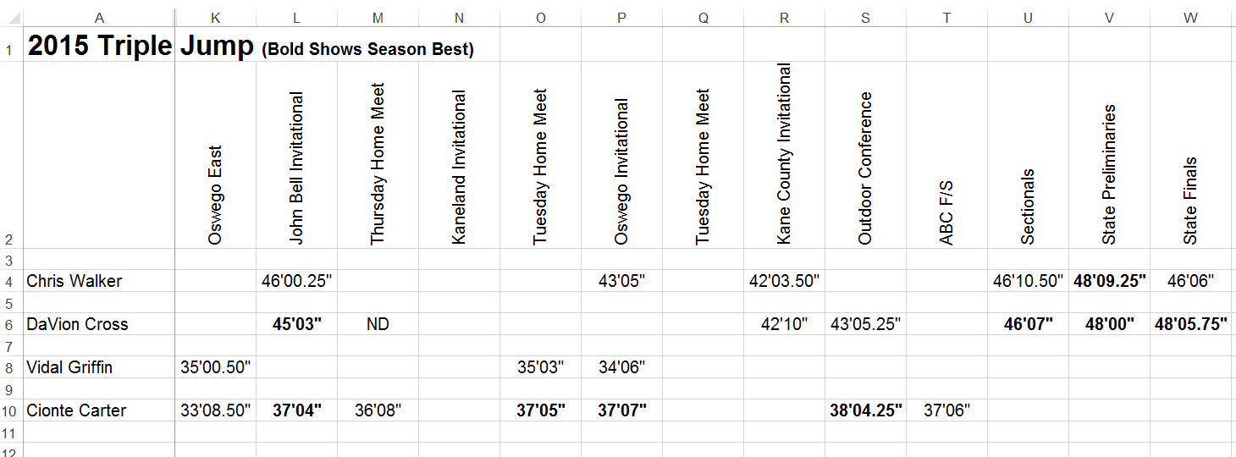
Record Keeping (Season Results)

Slide 14
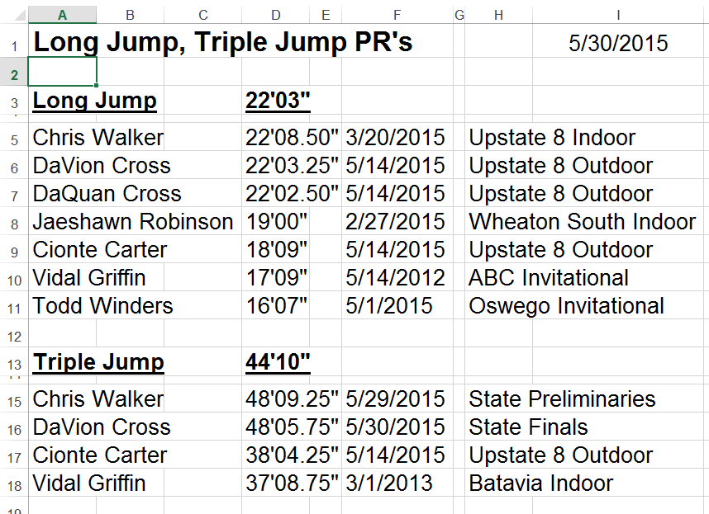
Record Keeping (PRs)

Slide 15
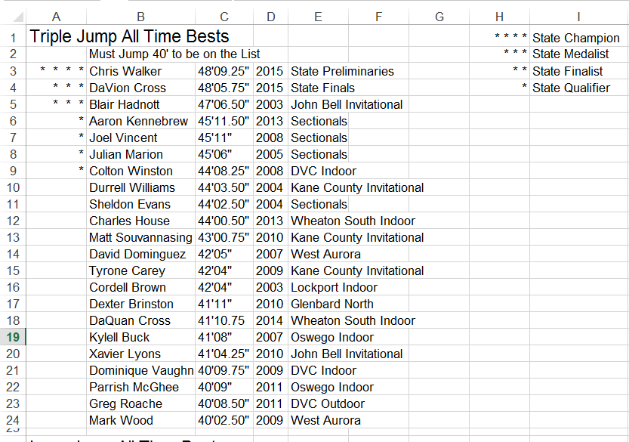
Record Keeping (All Time Bests)

Slide 16
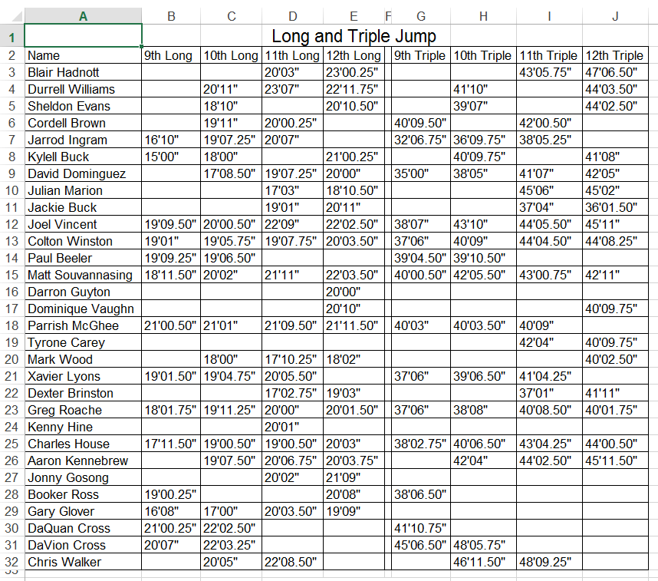
Record Keeping (Season Best by Year in School)

Slide 17
Miscellaneous
Meet Coaching
Mental Approach
What board to use

